Slide 1
NSF DMR MRSEC
Division of Materials Research (DMR)
Materials Research Science and Engineering Centers (MRSEC)
March 9, 2018
Dan Finotello
National Science Foundation MRFN WORKSHOP

Slide 2
Mathematical and Physical Sciences
MPS
Assistant Director
Office of Multidisciplinary Activities
$1.27B
(FY 14 budget)
$35 M
Astronomical Sciences
Chemistry
Materials Research
Linda Sapochak
$238 M $235 M $298 M
Mathematical Sciences
Physics
ONE OF THE LARGEST $$ DIVISIONS IN THE ENTIRE NSF
$267 M
$225 M

Slide 3
DIVISION OF MATERIALS RESEARCH (DMR)
Topical Materials Programs
Centers & Teams
National Facilities & Instrumentation Program
Biomaterials
Ceramics
Electronic & Photonic Materials
Metals and Metallic Nanostructures
Polymers
Condensed Matter & Materials Theory
Condensed Matter Physics
Solid State and Materials Chemistry
Jul 2019
Materials Research Science & Engineering Centers (MRSEC)
Cornell High Energy Synchrotron Source (CHESS)
National High Magnetic Field Laboratory (NHMFL)
Center for High Resolution
Neutron Scattering (CHRNS)
National Nanotechnology
Coordination Network (NNCI)
Materials Innovation Platforms (MIP)
Unsolicited Proposals, EAGER, RUI, GOALI (and CAREER*)
Partnerships in Research & Education in Materials (PREM)
Jan 2018
Cross-Cutting Activities
Diversity
International
Education
Jan 2019
Designing Materials to Revolutionize & Engineer our Future (DMREF)
User Facilities
Solicitations

Slide 4
MRSEC Expenditures 2017 % of Fixed Total Budget, $56 M/yr

Slide 5
MRSEC History
1960-61 - Interdisciplinary Research Labs (IDLs) -ARPA
1971 - Proposal to transfer IDLs to NSF as a result of the Mansfield Amendment (no defense related research)
1972 - NSF establishes DMR, MRL program (later MRGs)
1994 - DMR creates MRSEC program (4 Years Awards: 6 Years awards in 2002); 1-5 IRGs
2010/11 - DMR establishes CEMRI (Centers) and MIRT (small team) programs
2013/14 - DMR drops CEMRI/MIRT nomenclature: MRSEC returns with no MIRT; 2-5 IRGs
2016/17 – MRSEC: Completed August 2017; 2-3 IRGs
Notes:
DMR = NSF Division of Materials Research
ARPA = Advanced Research Project Agency
IDL Interdisciplinary Laboratory
MRL = Materials Research Laboratory
MRG = Materials Research Group
CEMRI = Centers of Excellence in Materials Research and Innovation

Slide 6
NSF Centers
2011
CEMRI/MIRT
IDL/MRL University | Year Initiated
Cornell | 1960
Pennsylvania | 1960
Northwestern | 1960
Chicago | 1961
Harvard | 1961
MIT | 1961
Pennsylvania State | 1974
Ohio State | 1982

Slide 7
CURRENT MRSECs: 20
CLASS of 2014
12 Awards: Brandeis, Chicago, Colorado, Columbia, Harvard, Minnesota, MIT, Nebraska, NYU, Ohio State, Penn State, Princeton.
CLASS of 2017
8 Awards: Cornell, Northwestern, UC Santa Barbara, U Penn, U Texas-Austin, U Washington, U of Illinois, U of Wisconsin.

Slide 8
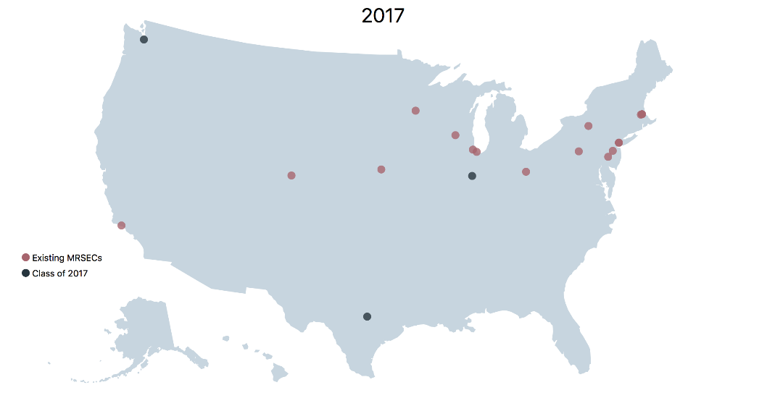
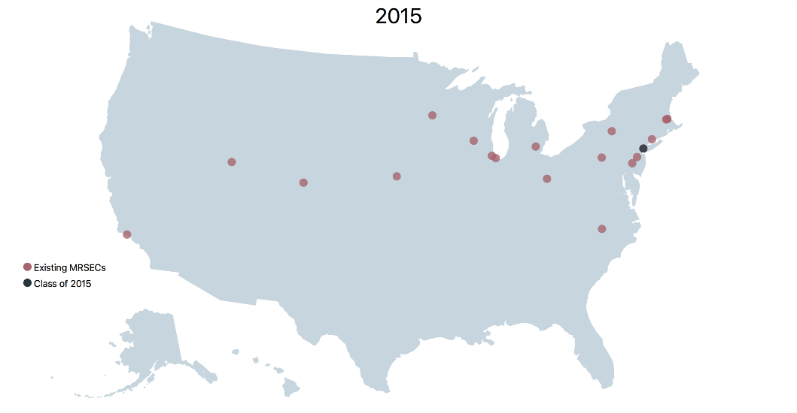
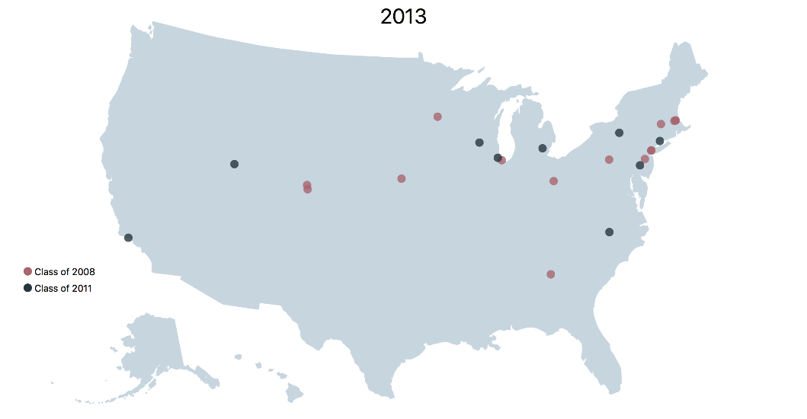
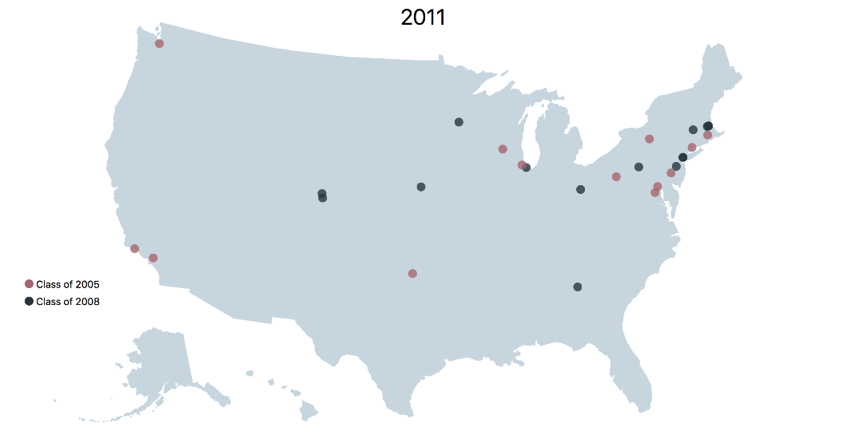
MRSEC Locations Through the Years

Slide 9
MRSEC Program Goals / Achievements
Stimulate and support outstanding interdisciplinary research and education in materials of a scope and complexity that requires a center.
All students, in or out of MRSEC benefit from it; network. Curriculum development. No departmental (jargon) barriers.
Critical mass of investigators of complementary/diverse expertise
Address fundamental, complex materials problems that are intellectually challenging and important to society
Foster partnerships between academia and industry, National labs, and international: transdisciplinarity
Re-competition model and Seed program provide a mechanism for reinvention and adaptation to address emerging areas (flexibility)
Leveraging of funds (NSF ~$56M; $44M other sources; Attract faculty. Start-up Companies ; Patents. Jobs creation/relocation
Materials Network Facilities Network (~ 10 years), www.mrfn.org

Slide 10
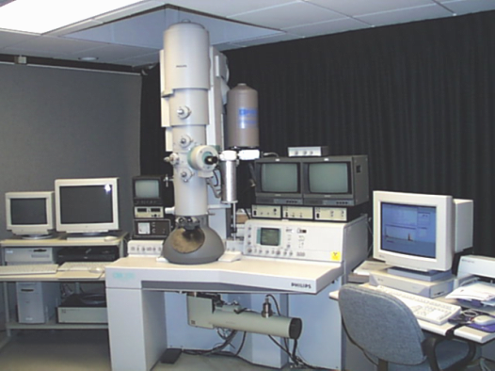
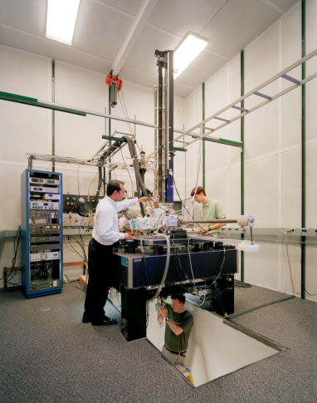
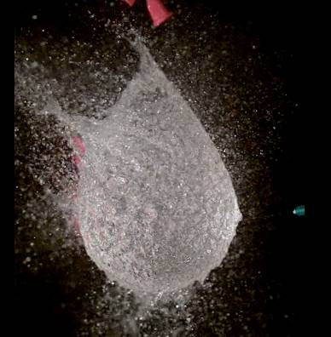
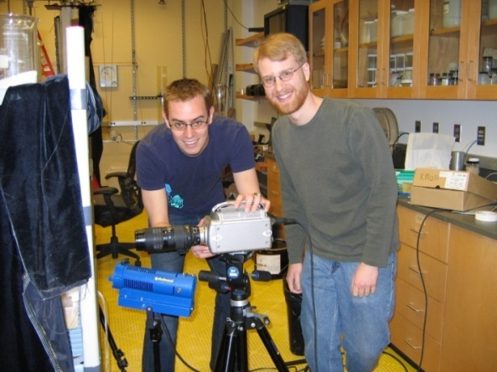
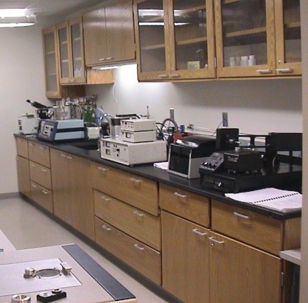
MRFN Statistics
23 centers 1141 instruments 262 experts
Recently added instruments
Thermogravimetric Analyzer
Thermogravimetric Analyzer Mass Spectrometer
mrfn.org
SEF Users (non MRSEC)
> 1455 Academic
> 703 Industry
> 48 National Labs
MRFN SEF Users: 606
823 Publications acknowledged MRSEC SEF in 2017; 743 in 2016; 806 in 2015
62 MRSEC Technical Staff in SEFs
34 Other Technicians

Slide 11
MRSEC Directors Meeting Minutes
Some of the potential topics to be discussed in the Workshop include best practices, funding models, recharge systems, consortia (including the MRFN), billing and reservation systems, remote operation associated with facilities for education (remote classrooms), data storage and big data initiatives.

Slide 12
Talking Points
1. External Use of Facilities
a. increasing industrial usage vs. academic research usage
b. how to get the word out, MRFN
c. meeting and managing expectations of external users
d. collaboration with industry on publishable work; IP considerations
e. determining charge rates for various kinds of work (service vs collaboration) and types of users (industry, govt, external academics)
2. Funding for Staffing, Instrumentation and Upkeep
a. How do facilities find routes for proper support beyond user fees?
b. advancing capabilities without increasing staffing costs
c. funding schemes for mid-range equipment
d. recharge strategies for non-traditional labs, i.e. computing or clean rooms
e. management systems to reduce administration

Slide 13
Talking Points
3. Staffing
a. level of expertise sought
b. level of involvement for advanced analytical work
c. strategies for keeping staff challenged and productive
d. collaboration/publication
e. independent scholarship
4. Training & Outreach
a. advanced user training, beyond basic measurements
b. preventing “black box” phenomenon for students
c. curricular participation
d. remote training and outreach for PREM partners and undergraduates
e. outreach strategies for increasing internal use

Slide 14
Talking Points
5. Data Management and Curation
a. making data public and accessible – meeting NSF requirements
b. What do we mean by curation? i.e. genome projects, protein structural database
c. Whose responsibility is this? University libraries, NSF, MRSEC Centers, PIs?
d. data management for data mining
e. metadata
What is the mission of MRFN?
Diversity Strategies
Educational/Training aspects
PUI Involvement
General Availability
Why are we doing it and what outcomes should we expect

